Slide 1
How do heavy things fly?

Slide 2

Model of Flight
Formula of lift force
$$F_{l}={\frac{1}{2}C}_{l} pv^{2} A$$
C_{l} = the lift coefficient
F_{l} = the lift force generated (measured in N)
ρ = the fluid density (measured in kg m^{–3})
v = the speed in the fluid (measured in m s^{–1})
A = the size of the wing in (measured in m² from the top down)

Slide 3
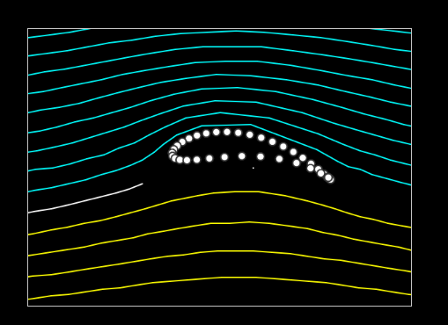
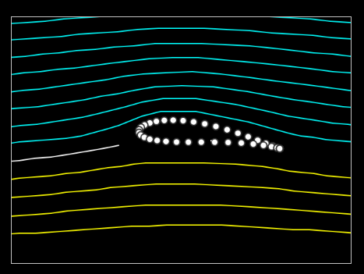
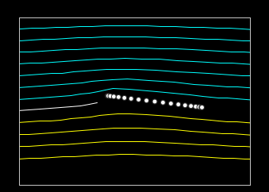
Finding the lift coefficient (C_{l})
Finding the lift coefficient is most common through practical experimentation such as wind tunnels or more recently computer simulations.
Lift coefficient can be impacted by:
- Angle of attack also known as AOA (angle of the wing compared to the velocity of the aircraft)
- Camber of the wing (how curved the wing is)
Examples: All have the same angle of attack
Play around yourself:
https://www1.grc.nasa.gov/beginners-guide-to-aeronautics/foilsimstudent/
“High Camber aerofoil”
Lift Coefficient = 2.38
“Low Camber (flat bottom) aerofoil”
Lift Coefficient = 1.32
“Flat plate”
Lift Coefficient = 0.72

Slide 4
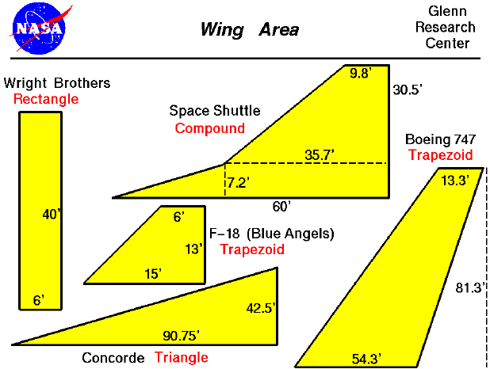
Finding the area of a wing (A)
Finding wing area is as simple as finding the area of the shapes they make up.
The most basic and common wing shapes is the straightforward rectangular wing
The more a wing is swept the less drag it has but losses lifting force
Unswept wings trade increased drag for increased lifting force and agility

Slide 5
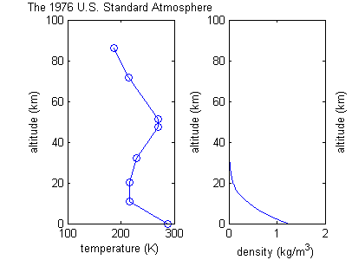
Finding atmospheric Fluid Density (ρ)
As the altitude of an aircraft increases the fluid density decreases
This means aircraft have difficulty flying at higher altitudes

Slide 6
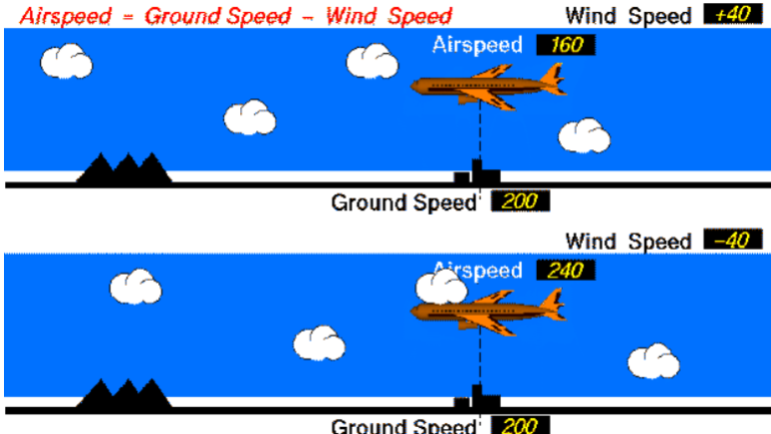
Finding Velocity (v²)
There are two types of speed when measuring how fast a wing is going
Airspeed (IAS, TAS)
Measurement of the speed relative to the air
Used in our lift calculation
Groundspeed - windspeed
Groundspeed
Measurement of the wing/aircraft’s speed relative to the ground

Slide 7
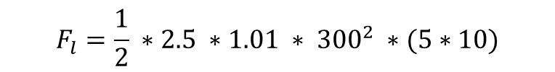
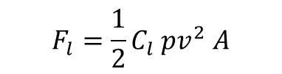

Practice Problem 1
Using the provided atmospheric density table find the lift force for an airspeed of 300 m/s⁻¹ at an altitude of 2000 meters, with a wing that has dimensions of 5 Wide and 10 Long. With a wing that has a lift correlation of 2.5
Altitude (m) | Atmospheric Density (kg/m³)
0 | 1.23
500 | 1.17
1000 | 1.11
1500 | 1.06
2000 | 1.01
3000 | 0.909
4000 | 0.819
5000 | 0.736
$$F_{l}={\frac{1}{2}C}_{l} pv^{2} A$$
$$F_{l}=\frac{1}{2} ∗2.5 ∗1.01 ∗ {300}^{2} ∗(5∗10)$$
$$F_{l}=5681250 n$$

Slide 8
Thrust of an aircraft and relations to newton’s laws

Slide 9
Recap: Newtons Laws
Newton’s First Law:
Objects remain in their state of rest and objects in motion remain at motion unless an external force is applied
Newton’s Second Law:
When an unbalanced force acts on an object, the object will accelerate in the direction of the force. (F = ma)
Newtons Third law:
That every action force has and equal and opposite reaction force

Slide 10
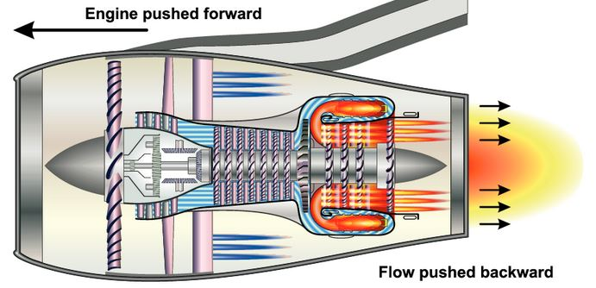
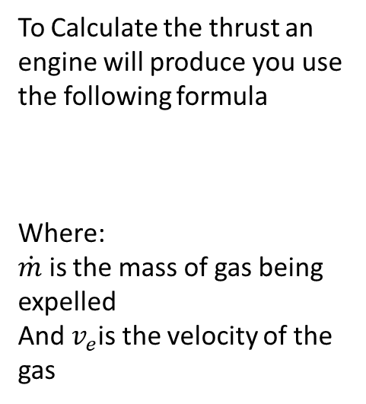

Newtons Third and Second Laws in Jet Engines
To Calculate the thrust an engine will produce you use the following formula
Where:
$\dot{m}$ is the mass of gas being expelled
And $v_{e}$is the velocity of the gas
$$F_{t}=\dot{m}∗v_{e}$$
High Bypass Turbofan

Slide 11



Sample Question
An airliner jet engine would expel 500kg of gas from the rear of the engine at a speed of 2500 m s⁻¹ what would the force of thrust be?
$$F_{t}=\dot{m}∗v_{e}$$
$$F_{t}=500∗2500$$
$$F_{t}=1.25 ∗{10}^{6} n$$

Slide 12
Sources and citations
Diagrams:
By Beojan - Own work, Public Domain, https://commons.wikimedia.org/w/index.php?curid=9805779
By. Buck Leupitsthlaw~commonswiki assumed (based on copyright claims). - No machine-readable source provided. Own work assumed (based on copyright claims)., CC BY-SA 3.0, https://commons.wikimedia.org/w/index.php?curid=1562383
By Glen Research Center, https://www.grc.nasa.gov/www/k-12/VirtualAero/BottleRocket/airplane/area.html
Airfoil camber relation, https://www1.grc.nasa.gov/beginners-guide-to-aeronautics/foilsimstudent/
High bypass Turbofan Newtonian, http://essentialpilot.co.za/wp-content/uploads/2019/01/Jet-Engine.jpg
Airspeed vs groundspeed, https://www.grc.nasa.gov/www/k-12/airplane/Animation/airrel/anrelg.html
Citations
U.S. standard atmosphere (2024) Wikipedia. Available at: https://en.wikipedia.org/wiki/U.S._Standard_Atmosphere (Accessed: 23 June 2025).
NASA (2014). Lift Formula. [online] Nasa.gov. Available at: https://www.grc.nasa.gov/WWW/K-12/WindTunnel/Activities/lift_formula.html.
Engineering Toolbox (2012). International Standard Atmosphere. [online] Engineeringtoolbox.com. Available at: https://www.engineeringtoolbox.com/international-standard-atmosphere-d_985.html.
Jacaranda (2019). Jacaranda physics 1 VCE units 1 and 2 fourth edition learnON and print. Milton, Qld: John Wiley & Sons Australia, Ltd.
Benson, T. (2014). Newton’s Third Law of Motion. [online] Nasa.gov. Available at: https://www.grc.nasa.gov/WWW/BGH/newton3.html.
https://www.uwa.edu.au/science/-/media/faculties/science/docs/newtons-laws-of-motion.pdf
‌
‌

Slide 13
C.A.R Test
1. NASA (2014). Lift Formula. [online] Nasa.gov. Available at: https://www.grc.nasa.gov/WWW/K-12/WindTunnel/Activities/lift_formula.html.
Currency: 2014 is suitable time for subjects such as determining lift as so major breakthroughs have been made sense then and remaining near about 10 years old. The resource still remains useful to the current date.
Authority: NASA is a reputable source of information, being a government agency and an organisation that conducts hands on practical experimentation. This reinforces the validity of this source
Reason: This source was made with an expectation of education, being designed for the American school system. Proving the relevancy and intention of it.
2. By. Buck Leupitsthlaw~commonswiki assumed (based on copyright claims). - No machine-readable source provided. Own work assumed (based on copyright claims)., CC BY-SA 3.0, https://commons.wikimedia.org/w/index.php?curid=1562383
Currency: The resource is dated to 1976 which is the latest available version
Authority: The 1976 us standard atmosphere was a revision to a test conducted by the US government
Reason: The reason was to identify the atmospheric standard of pressure, temperature and density

